Slide 1
Microservices: Evaluating the effect of drought and management system on ammonia oxidizer communities (nitrifiers) in wheat field soil

Slide 2
Sequencing summary
Number of samples: 192
Illumina MiSeq 2 x 250 bp
 | AOB | AOA
Total raw reads | 3,801,391 | 2,130,641
Total quality-filtered reads | 1,806,442 | 1,528,985
Total ASVs | 1,338 | 646

Slide 3
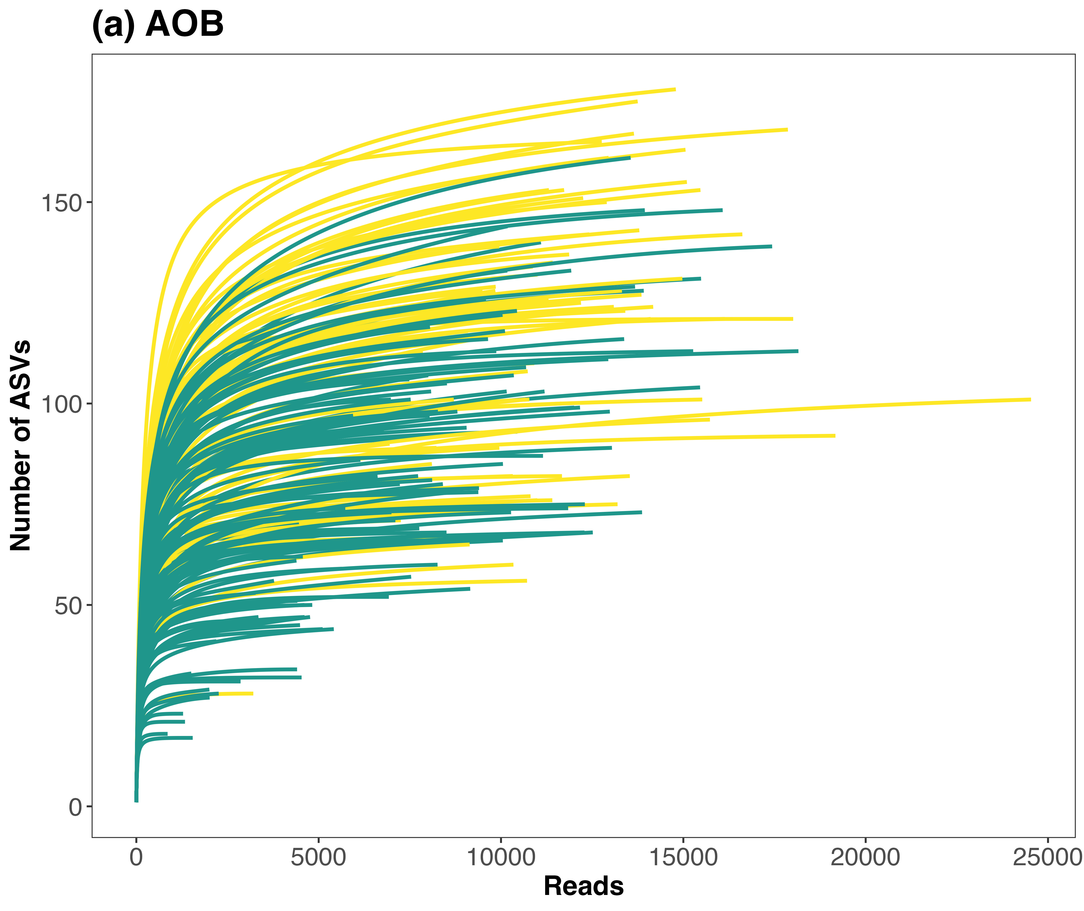
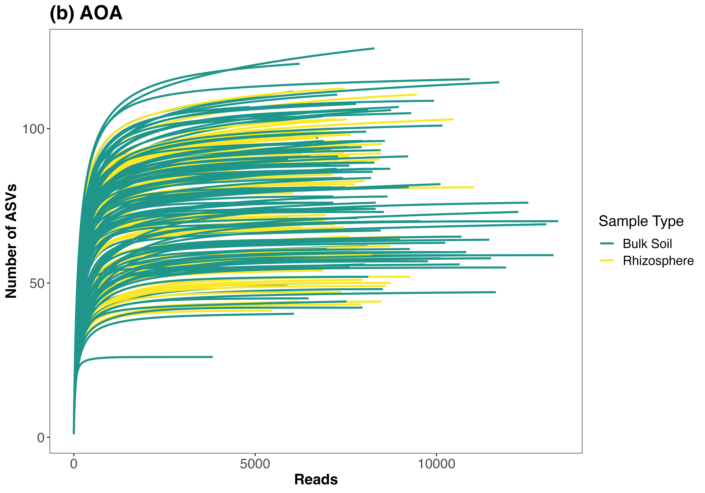
Rarefaction curve

Slide 4
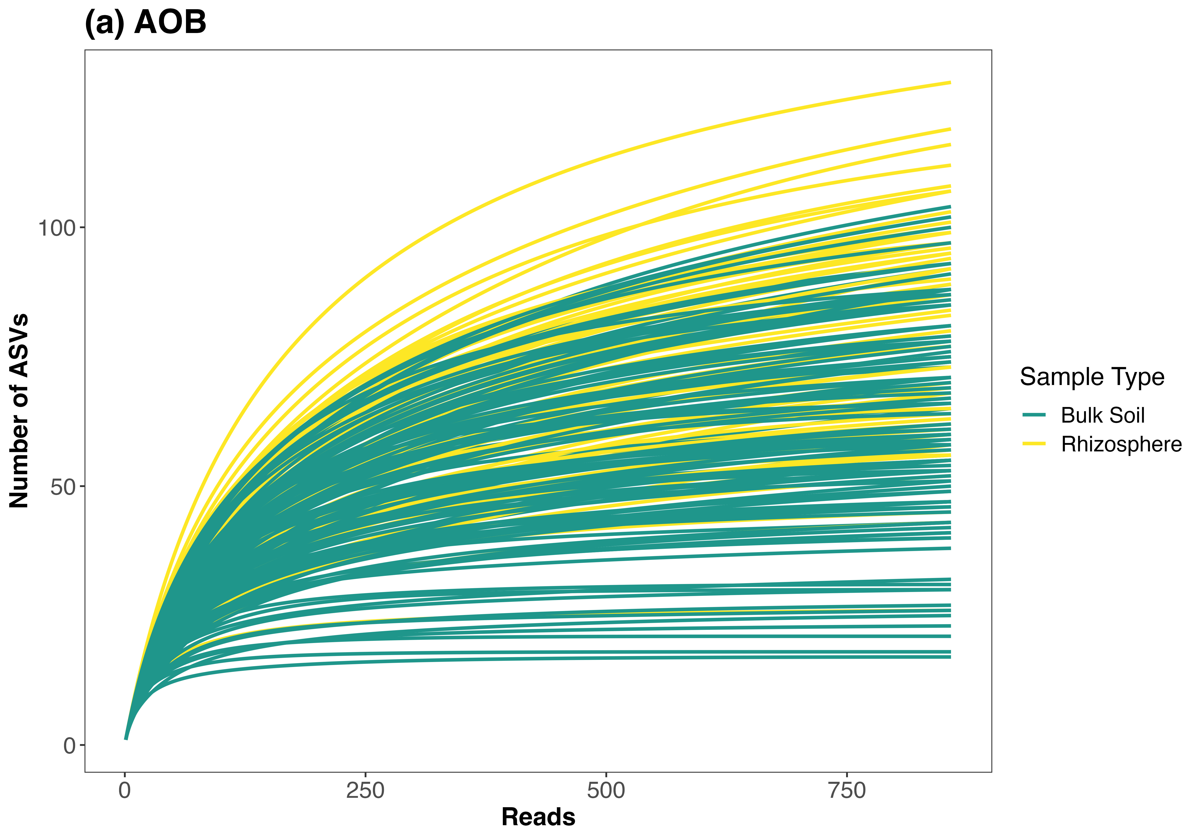
Rarefy AOB to the minimum sequencing depth
178 OTUs were removed because they are no longer present in any sample after random subsampling
no sample removed

Slide 5
Removed ASVs when rarefy AOB at 2k (all bulk soil samples)
ASVid | # Reads | Irri. | Treat. | Date
3 | 1335 | Control | D | 28/04/22
6 | 1509 | Rain | K | 28/04/22
11 | 858 | Control | D | 28/04/22
35 | 1282 | Control | D | 01/06/22
52 | 1546 | Rain | D | 05/07/22
102 OTUs were removed because they are no longer present in any sample after random subsampling
5 samples were removed

Slide 6
Removed ASVs when rarefy AOB at 3k:
75 OTUs were removed because they are no longer present in any sample after random subsampling
11 samples were removed (not good)
SampleID | Reads | Irrigation | Treat. | Date
S11 | 858 | Control | D | 4/28/22
S35 | 1282 | Control | D | 6/1/22
S3 | 1335 | Control | D | 4/28/22
S6 | 1509 | Rainout | K | 4/28/22
S52 | 1546 | Rainout | D | 7/5/22
S7 | 2003 | Control | K | 4/28/22
S87 | 2010 | Control | M | 7/20/22
S4 | 2194 | Rainout | D | 4/28/22
S2 | 2260 | Rainout | M | 4/28/22
S9 | 2693 | Control | M | 4/28/22
S12 | 2859 | Control | D | 4/28/22

